Slide 1
The Prereversal Enhancement 3.4 Further Complexities of Equatorial Electrodynamics
Tzu-Ya (Ethan), Tai pp. 99-102
April 3, 2019

Slide 2
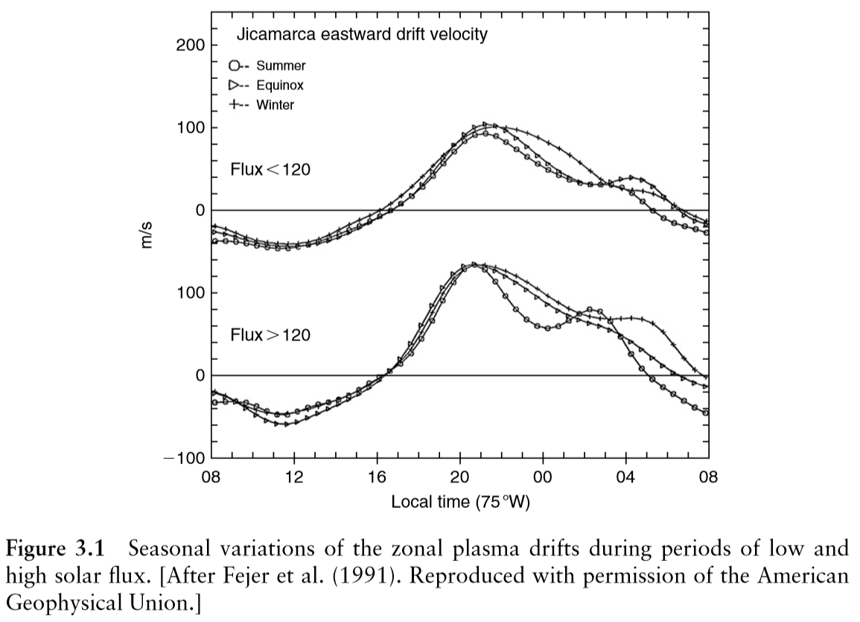
3.4 Further Complexities of Equatorial Electrodynamics
p. 99
The simple E- and F-region dynamos just described explain some of the observations presented earlier in Fig. 3.1.
Since the E region controls the physics during the day, the small daytime vertical electric ﬁelds in the F region presumably mirror the meridional E-region polarization ﬁelds in the latitude ranges just north and south of the equator.
(p. 73)

Slide 3
3.4 Further Complexities of Equatorial Electrodynamics
p. 99
The zonal ﬁeld, both daytime and nighttime, is global in nature and is driven by the large-scale tides and winds in the sunlit hemisphere. In the postsunset period, the F-layer vertical ﬁeld is enhanced due to the local F-layer dynamo previously discussed. In the next paragraphs we point out some of the features not explained by these simple models.

Slide 4
3.4.1 The Prereversal Enhancement
p. 99
The postsunset enhancement or prereversal enhancement of the zonal ﬁeld occurs during all epochs and seasons studied except for the solar minimum solstices.
The effect of this brief duration, large eastward electric ﬁeld can be quite signiﬁcant since the F-layer plasma often is driven to very high altitudes where recombination is slight and collisions are rare.

Slide 5
p. 99
Heelis et al. (1974) successfully predicted the postsunset effect in their model, which included horizontal conductivity gradients near sunset in the F-layer dynamo mechanism (in addition to the vertical gradients we have studied).
In effect, near such a sharp east-west gradient, an enhanced zonal electric ﬁeld is established to keep ∇·J = 0.
Experimental data support this explanation since the enhancement begins when the sun sets on either of the E layers in contact along B with the equatorial F region.

Slide 6
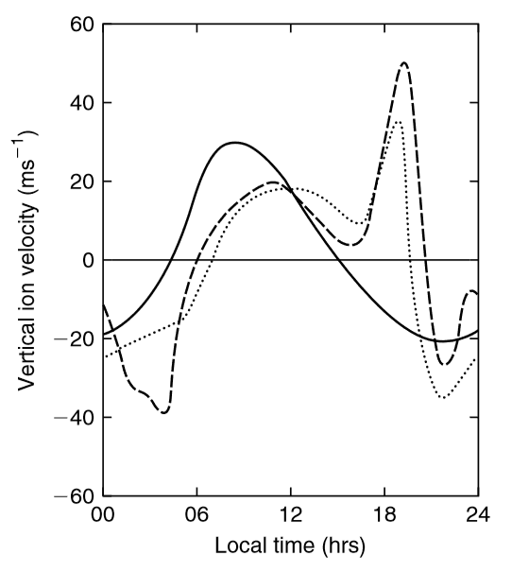
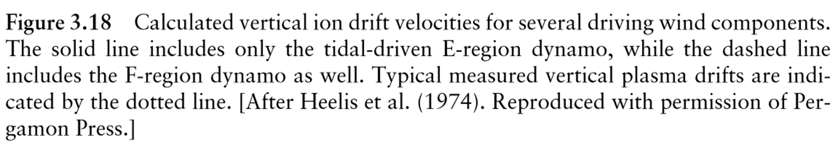
pp. 99-100
The evidence from their numerical simulation is presented in Fig. 3.18.

Slide 7
The solid line shows the calculated vertical ion velocity in the F region (equivalent to a zonal electric ﬁeld) when only a diurnal E-region tidal mode is considered.
The basic day-night features are reproduced, but no prereversal enhancement occurs.
The dashed line shows a calculation including the F-region dynamo in the physics.
The latter agrees quite well with the dotted line, which is a typical vertical drift proﬁle for the plasma over Jicamarca.
pp. 99, 100

Slide 8
The solid line shows the calculated vertical ion velocity in the F region (equivalent to a zonal electric ﬁeld) when only a diurnal E-region tidal mode is considered.
The basic day-night features are reproduced, but no prereversal enhancement occurs.
The dashed line shows a calculation including the F-region dynamo in the physics.
The latter agrees quite well with the dotted line, which is a typical vertical drift proﬁle for the plasma over Jicamarca.
pp. 99, 100

Slide 9
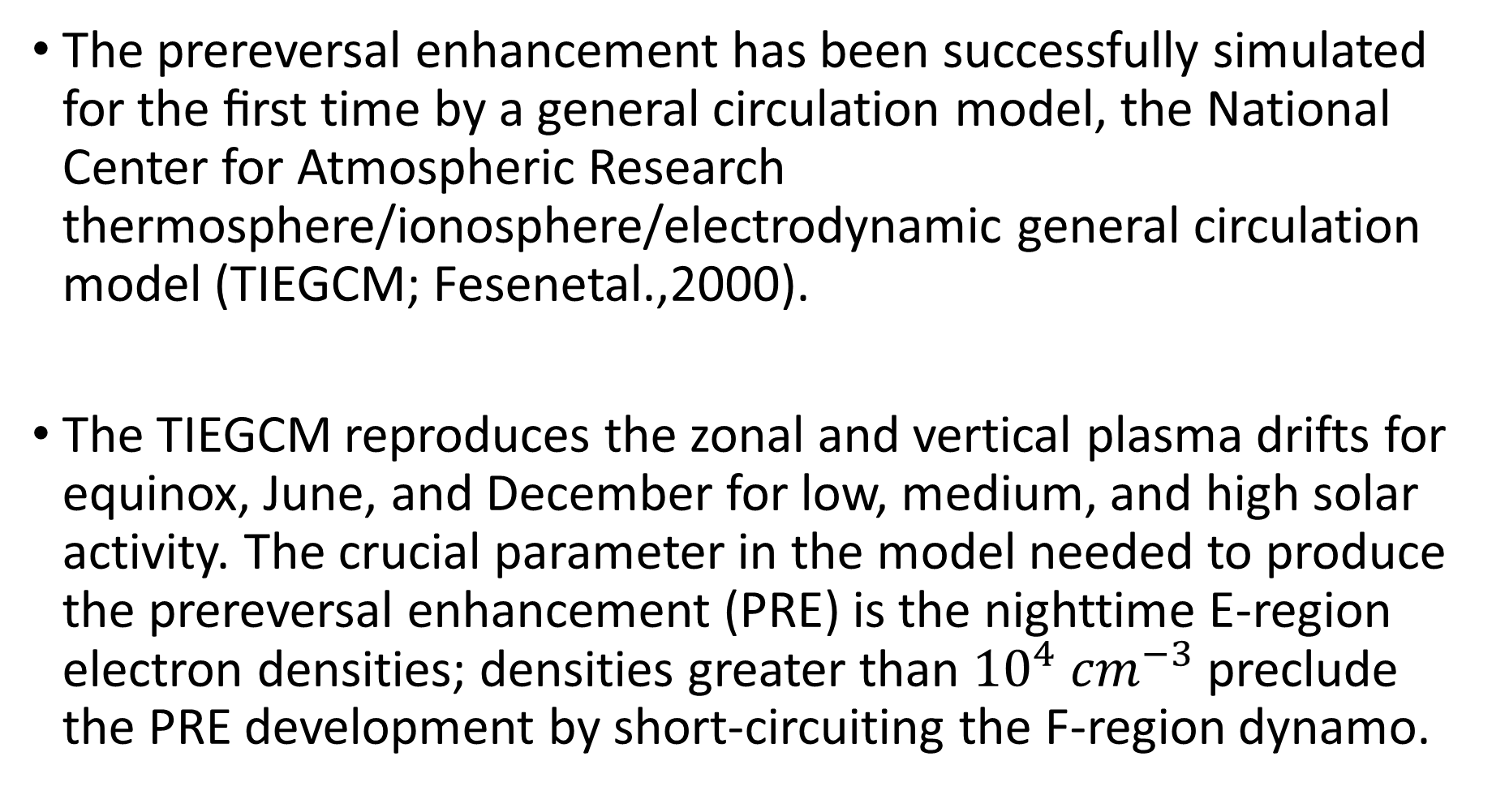
The prereversal enhancement has been successfully simulated for the ﬁrst time by a general circulation model, the National Center for Atmospheric Research thermosphere/ionosphere/electrodynamic general circulation model (TIEGCM; Fesenetal.,2000).
The TIEGCM reproduces the zonal and vertical plasma drifts for equinox, June, and December for low, medium, and high solar activity. The crucial parameter in the model needed to produce the prereversal enhancement (PRE) is the nighttime E-region electron densities; densities greater than ${10}^{4}$ ${cm}^{−3}$ preclude the PRE development by short-circuiting the F-region dynamo.
p. 99

Slide 10
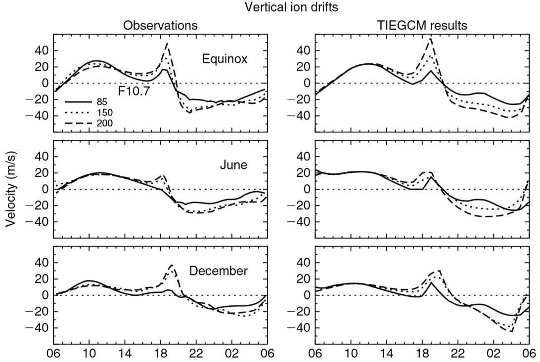
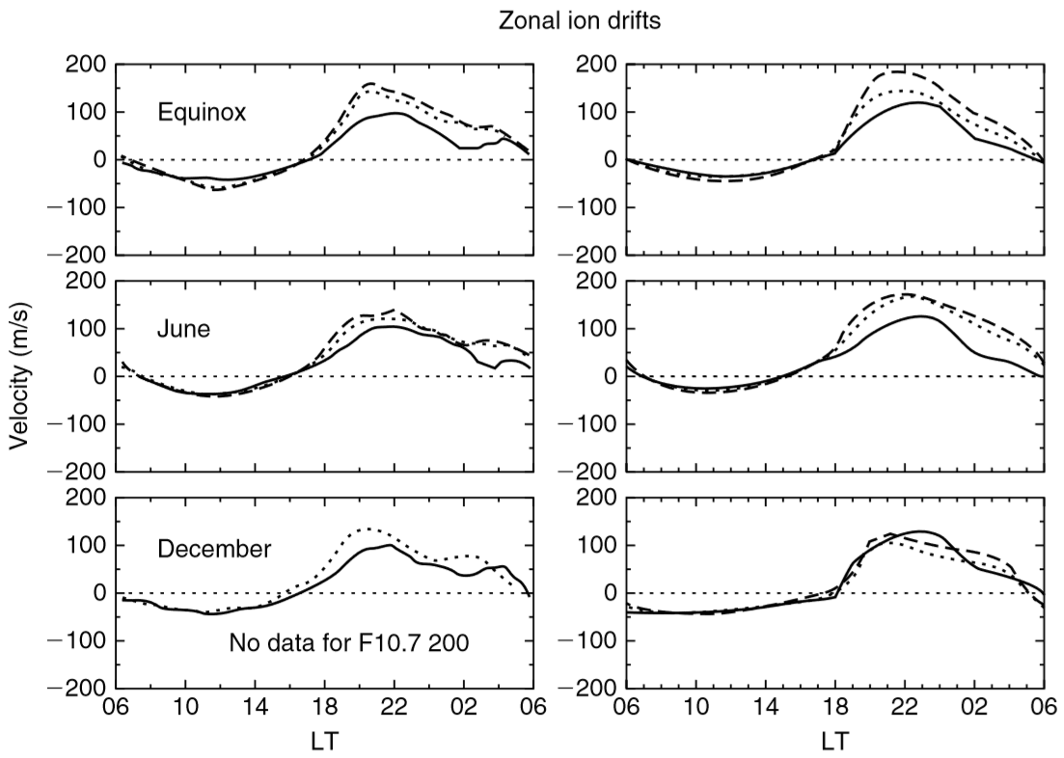
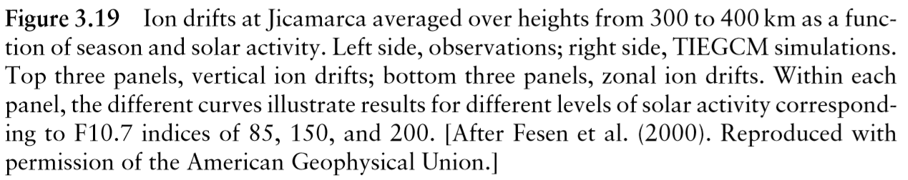
The E-region semidiurnal 2,2 tidal wave largely determines the magnitude and phase of the daytime F region drifts in this model (see Fig. 3.19).
pp. 100, 101

Slide 11
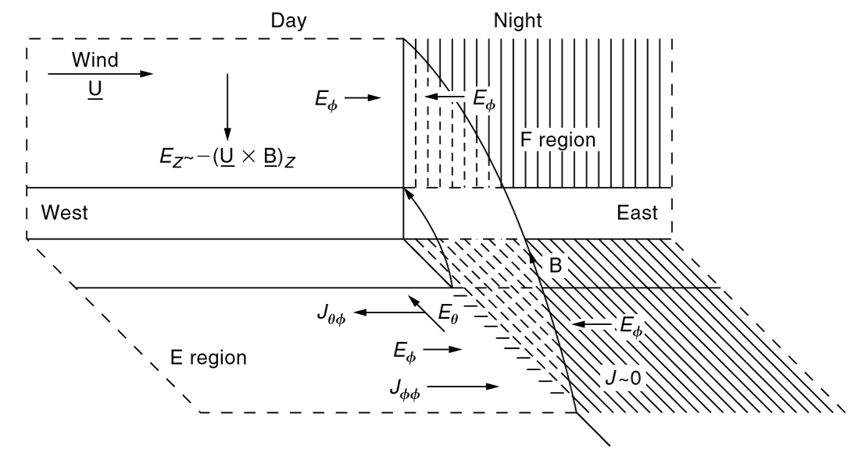
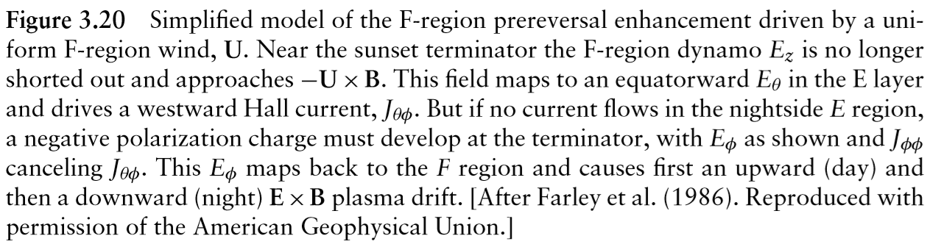
A simple sketch that may explain the prereversal enhancement is given in Fig.3.20.
The equatorial plane is shown here as a vertical plane, and its projection onto the Southern Hemisphere along B is also shown.
The wind blows across the terminator, generating a vertical electric ﬁeld, Ez, which is downward on both sides of the terminator.
pp. 100, 102

Slide 12
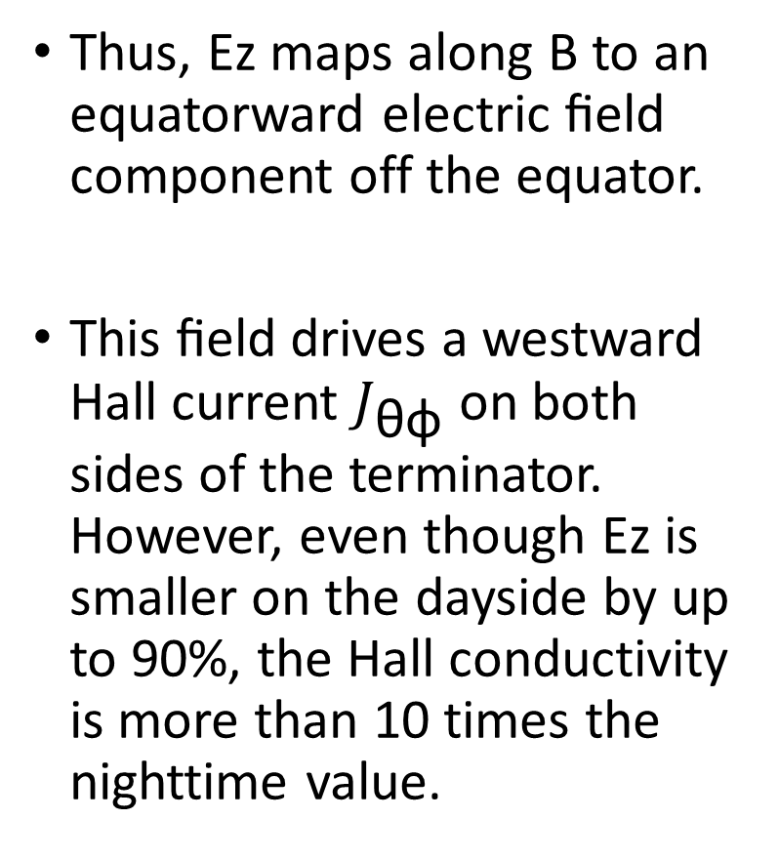
Ez is much smaller on the dayside than on the nightside due to the shorting effect, but it is never zero.
Thus, Ez maps along B to an equatorward electric ﬁeld component off the equator.
This ﬁeld drives a westward Hall current $J_{\text{θφ}}$ on both sides of the terminator. However, even though Ez is smaller on the dayside by up to 90%, the Hall conductivity is more than 10 times the nighttime value.
pp. 100, 102

Slide 13
The result is that a negative charge density builds up near the terminator, creating the localized zonal Eφ perturbation (the PRE) shown in the ﬁgure.
pp. 100, 102

Slide 14
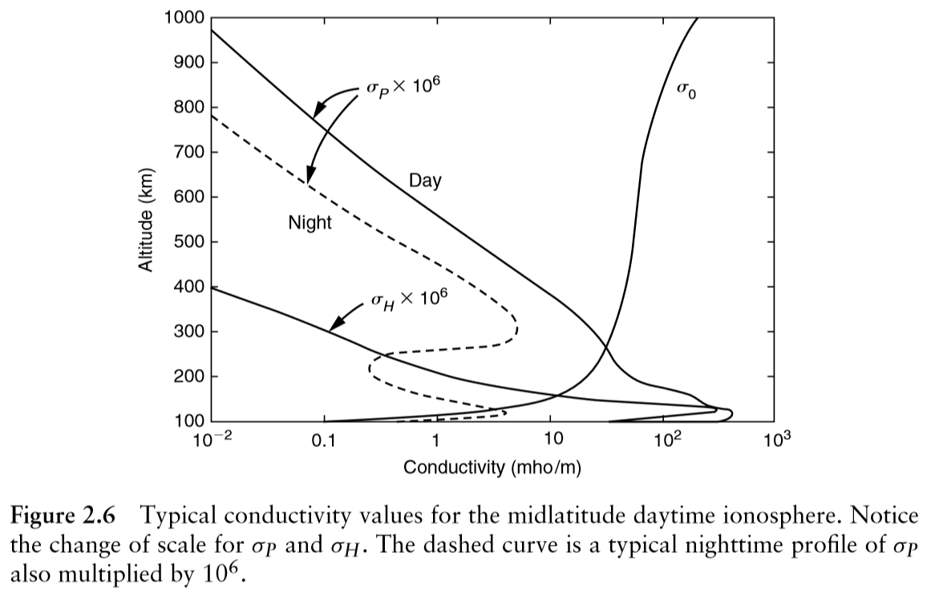
(p. 46)
pp. 100, 102

Slide 15
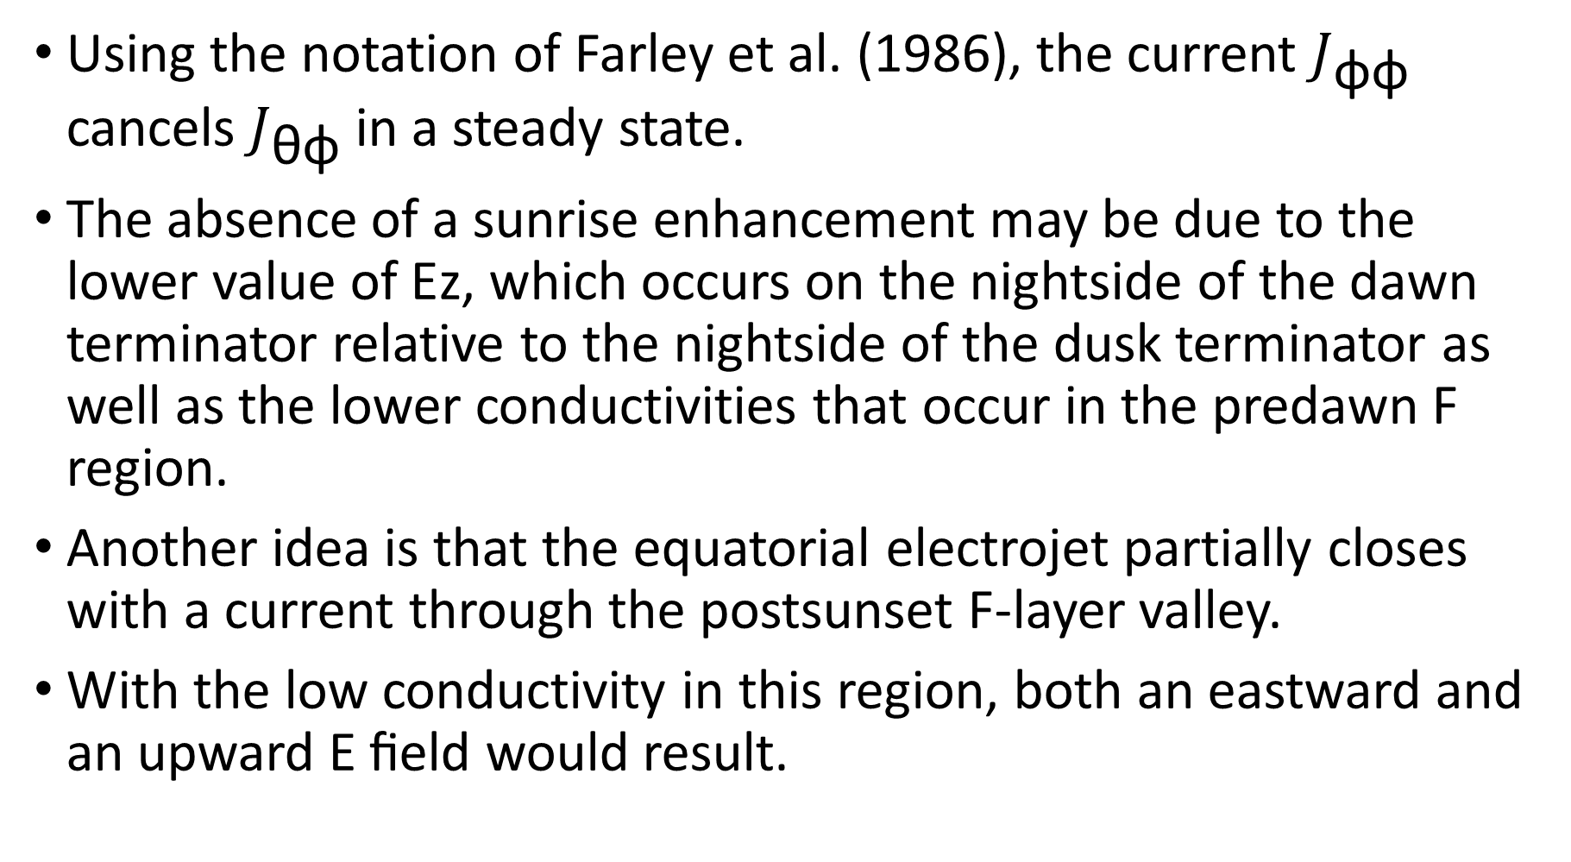
Using the notation of Farley et al. (1986), the current $J_{\text{φφ}}$ cancels $J_{\text{θφ}}$ in a steady state.
The absence of a sunrise enhancement may be due to the lower value of Ez, which occurs on the nightside of the dawn terminator relative to the nightside of the dusk terminator as well as the lower conductivities that occur in the predawn F region.
Another idea is that the equatorial electrojet partially closes with a current through the postsunset F-layer valley.
With the low conductivity in this region, both an eastward and an upward E ﬁeld would result.
pp. 100, 102

Slide 16
This could explain both the prereversal enhancement and westward ﬂows seen below the F peak (R.Heelis, personal communication, 2002).
On the other hand, Eccles (1998a, b) pointed out that simply setting ∇ × E = 0 will generate a zonal electric ﬁeld pulse due to the spatial variation of the vertical component.
A third mechanism by Haerendel and Eccles (1992) suggests that the electrojet partially closes after sunset through a poorly conducting F-region valley, creating electric ﬁelds.
After studying a counterelectrojet event that produced a reversed sign of the PRE, Kelley et al. (2009a) concluded that the Haerendel /Eccles mechanism must dominate.
p. 102

Slide 17
As we shall see, this vertical drift enhancement has many interesting consequences. It can produce conditions that are favorable to plasma instabilities, and an extremely structured ionosphere often results (see Chapter 4). Signiﬁcant effects on neutral atmospheric dynamics also occur.
p. 102

Slide 18
Electrodynamics of the equatorial evening ionosphere: 1. Importance of winds in different regions Richmond, A. D., T‐W. Fang, and Astrid Maute. "Electrodynamics of the equatorial evening ionosphere: 1. Importance of winds in different regions." Journal of Geophysical Research: Space Physics 120.3 (2015): 2118-2132.
Electrodynamics of the equatorial evening ionosphere: 2. Conductivity influences on convection, current, and electrodynamic energy flow Richmond, A. D., and T‐W. Fang. "Electrodynamics of the equatorial evening ionosphere: 2. Conductivity influences on convection, current, and electrodynamic energy flow." Journal of Geophysical Research: Space Physics 120.3 (2015): 2133-2147.

Slide 19
A simple model of low‐latitude electric fields Eccles, J. Vincent. "A simple model of low‐latitude electric fields." Journal of Geophysical Research: Space Physics 103.A11 (1998): 26699-26708.
Modeling investigation of the evening prereversal enhancement of the zonal electric field in the equatorial ionosphere Eccles, J. Vincent. "Modeling investigation of the evening prereversal enhancement of the zonal electric field in the equatorial ionosphere." Journal of Geophysical Research: Space Physics 103.A11 (1998): 26709-26719.
The role of the equatorial electrojet in the evening ionosphere Haerendel, Gerhard, and J. V. Eccles. "The role of the equatorial electrojet in the evening ionosphere." Journal of Geophysical Research: Space Physics 97.A2 (1992): 1181-1192.

